Slide 1
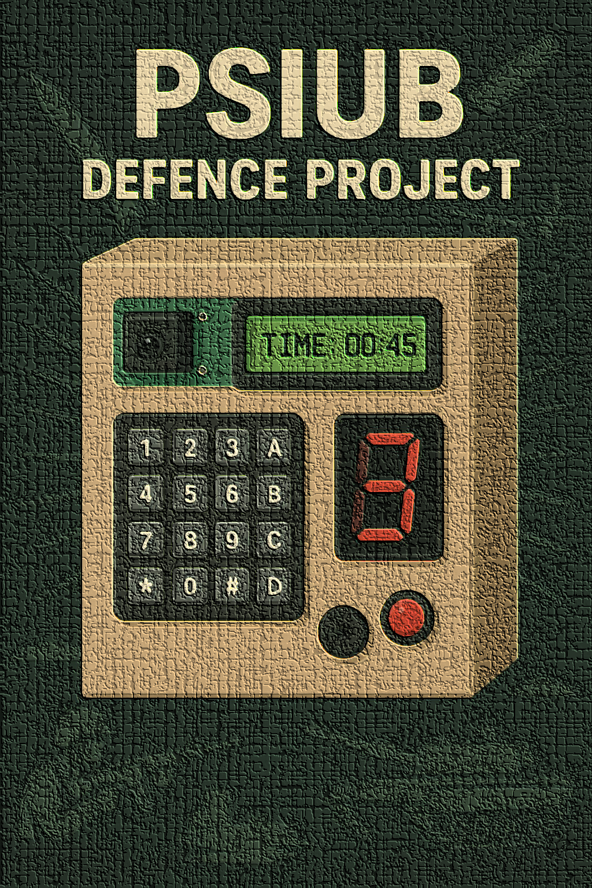
PSIUB
Perimeter Surveillance Interface Unit with Buzzer
–By shlok.

Slide 2
Problem Statement
Increasing security threats to sensitive installations.
Need for a low-cost, portable, and efficient intrusion detection solution.
Defence requirement: quick deployment in the field.

Slide 3
Objective
Detect unauthorized entry using IR sensors.
Provide instant visual & audio alerts.
Show countdown timer for breach time tracking.
Enable secure code entry via keypad to disarm.

Slide 4
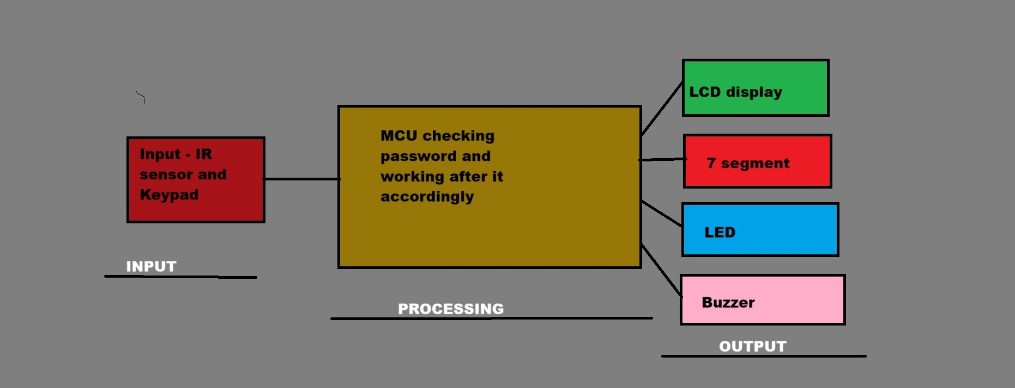
BLOCK DIAGRAM

Slide 5
Hardware Components
IR Sensor – Motion/intrusion detection { in simulation switch is representing the sensor to create interrupt}
Keypad – Code input for disarm/authentication
LCD – Timer & system status display
LED – Visual breach alert
Buzzer – Audible alarm
7-Segment Display – Single-digit status/count display
8051 MCU – Core processing unit

Slide 6
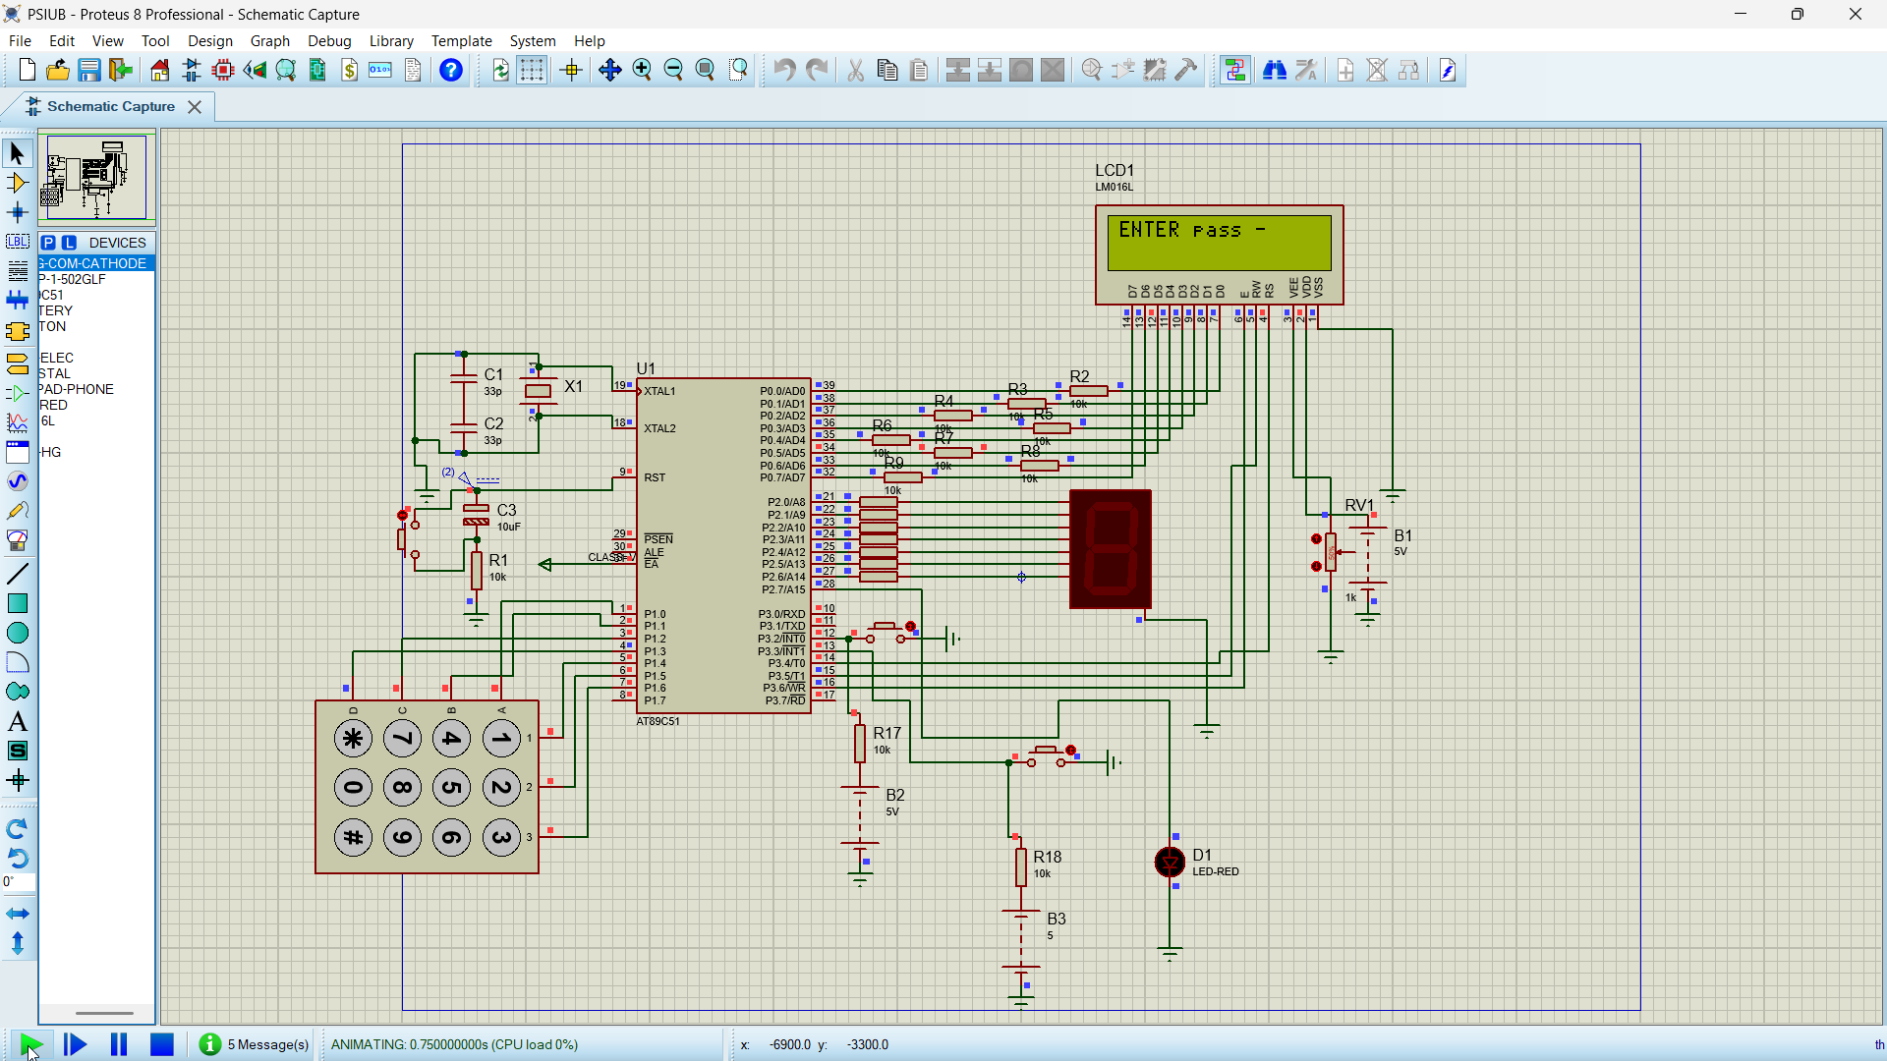

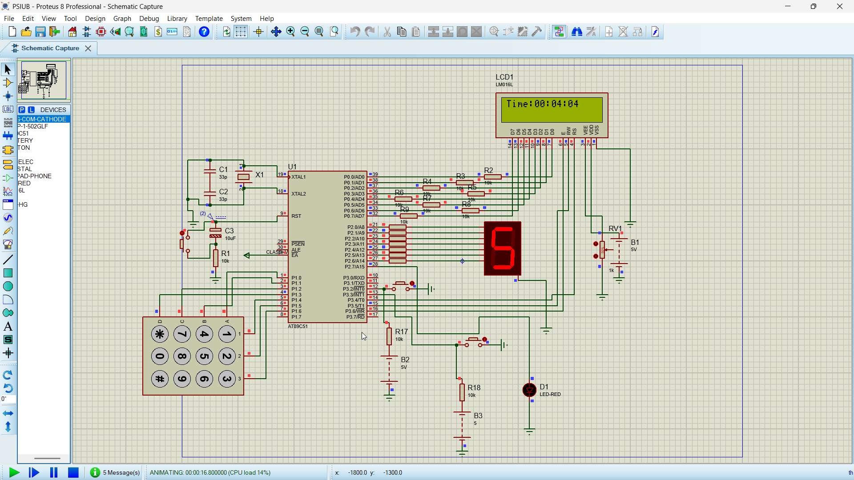

Slide 7

FLOWCHART
Start ↓
Initialize LCD, Ports, and Variables ↓
Display "ENTER pass -" on LCD ↓
Configure External Interrupt 0 (EX0) ↓
Configure Timer0 (Mode 1) for 1-second count ↓
Enable Global Interrupts (EA) ↓
Wait for Password Entry ↳ Key Press?
No → Stay in loop
Yes → Store in entered[] and show on LCD ↓
If 3 digits entered ↳ Compare with Corrpass
Match → Show "Access Granted", set passd = 1
Mismatch → Show "Wrong Pass!", reset POS ↓
After Access Granted → Enter Main Loop

Slide 8
Main Loop Checks:
If ckfg==1 (set by Timer0 ISR) → Update LCD with current Time (hh:mm:ss) → Reset ckfg=0
If sevsegfg==1 (set by EX0 ISR) → Increment sevsegg → Display on 7-segment (dnseg() function) → Reset sevsegfg=0
Other non-blocking tasks can be placed here ↓
Repeat Forever
Interrupt Routines:
Timer0 ISR:
Increment seconds, minutes, hours.
If limits reached, reset and carry over.
Set ckfg=1 to notify main loop.
External Interrupt 0 ISR:
Set sevsegfg=1 to notify main loop.
Toggle LED.

Slide 9
New Approach learnt during this project -
My Old Logic did -
Blocking loops (keypad, 7-seg, delays) → MCU stuck, events missed.
New Event-Driven Logic
Timers → periodic tasks (clock, LEDs).
Interrupts → instant reactions (buttons, sensors).
Flags → communicate between ISR & main loop.
How It Works
Timer ISR updates flags → main loop acts.
Interrupt ISR sets flags → main loop responds.
Main loop never blocked, MCU free for other tasks.
Benefits
Non-blocking, responsive, efficient, scalable.
Hardware vs Simulation
Hardware: Real events & precise timers.
Simulation: Adjusted logic, same principles.

Slide 10
Applications
Border post security.
Ammunition storage monitoring.
Military camp perimeter security.
Sensitive room access control.
Disaster relief temporary shelter protection.
Advantages
Fast deployment in the field.
Cost-effective compared to industrial security systems.
User-friendly with clear display and simple controls.
Reliable for critical defence scenarios.

Slide 11
Conclusion & Future Scope
Successfully developed a compact intrusion alert system.
Scope: integrate GSM module, wireless sensor nodes, solar power.
Can be adapted for civilian and defence use.
THANK YOU
Visit our GitHub profile from website to see its files and codes

